Slide 1

Strategic Sending
Selected Slides to help explain Strategic Sending. You can choose to use some or all of these in a presentation.
December 2025

Slide 2
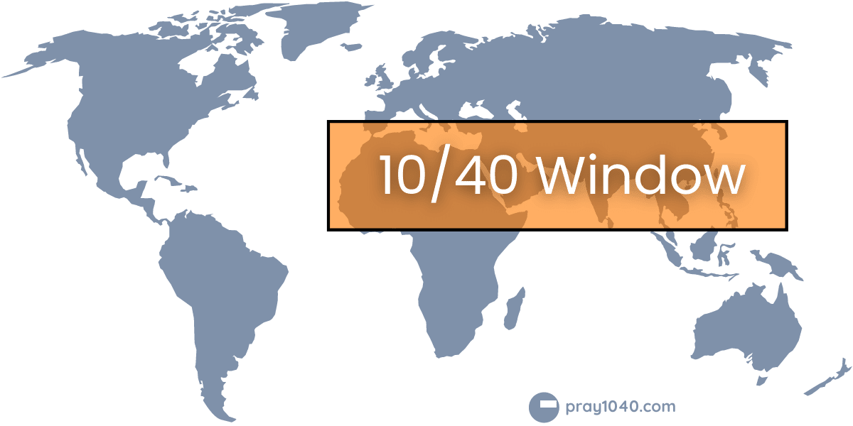
“The 10 / 40 Window” on a map. It has been an excellent aid to focus global mission

Slide 3
“The 10 / 40 Window” by population. 2/3rds in, 1/3rd out
World
10/40 Window

Slide 4
Strategic Sending gives the churches in each region their own “window”
World
Some Smaller
Strategic Sending
“Window”
Some Larger

Slide 5
The Whole Church taking the Whole Gospel to the Whole World
Good Focus
Good Coverage
In Relationship
On Task
..as in Nehemiah 3

Slide 6

100% of the Church to 100% of the World
“World evangelization requires the whole Church to take the whole gospel to the whole world” Lausanne Covenant 1974. YES!
BUT it doesn’t require each part of the Church to take the whole gospel to the whole world
So Strategic Sending divides up the task and recommends…
Each part of the Church to take the whole gospel to specific parts of the world.
Imagine if each 1% of the Church were to take the gospel to an appropriate 1% of the world…

Slide 7
Strategic Neighbourly Sending could send more than 60% of Church
to more than 60% of World (18% of the Church to 18% of the world in East Asia alone!)
d
Eurasia
Europe
North America
East Asia 18%
MENA
South Asia
Francophone Africa
South East Asia
Anglophone Africa
10%
Latin America 8%
Oceania
From the Strategic Sending data model using input data of population and evangelical Christian numbers sourced from Joshua Project and CityVision in 2025.

Slide 8
…but Strategic Distant Sending is required to reach the other 40%
Less Church than average
Eurasia
Europe
North America
+9%
East Asia
MENA
South Asia
-19%
Caribbean
Francophone Africa
South East Asia
Anglophone Africa
+17%
Latin America +10%
From the Strategic Sending data model using input data of population and evangelical Christian numbers sourced from Joshua Project and CityVision in 2025.
Oceania
More Church than average

Slide 9
These are the four major directions for Strategic Distant Sending
Strategic Receiving Regions
Eurasia
Europe
North America
+9%
7%
East Asia
MENA
South Asia
-19%
Caribbean
4%
Francophone Africa
South East Asia
3%
11%
Anglophone Africa
+17%
Latin America +10%
From the Strategic Sending data model using input data of population and evangelical Christian numbers sourced from Joshua Project and CityVision in 2025.
Oceania
Strategic Sending Regions

Slide 10
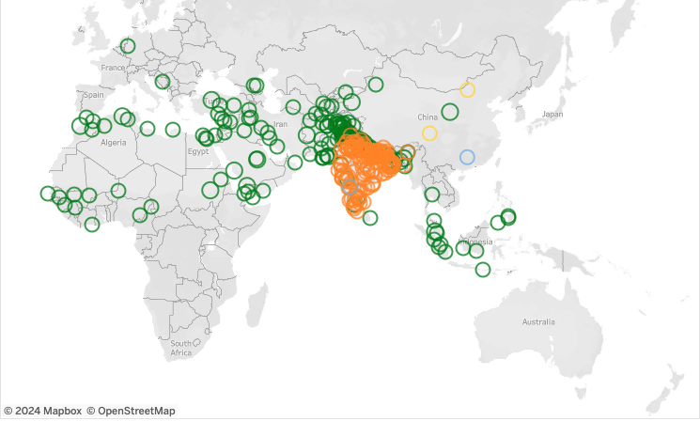
Frontier Peoples with more than a Million Population each
Strategic Sending strongly supports sending to least reached peoples.
283 of these 284 Frontier Peoples with more than a million population are centred in regions that Strategic Sending indicates need outside assistance.
Buddhists
Muslims
Hindus
In Frontier Peoples fewer than 1 in 1,000 follow Chris.
Copied from JoshuaProject.net December 2024

Slide 11

R.N.A. – Resources, Needs and Affinities
The data behind Strategic Sending
Resource:
Evangelical Christians
Need:
Population
Affinity:
Physical Distance
Language
Country
Bigger Harvest + Fewer Workers

Slide 12

Listen to the message to your church

Slide 13
Speaking from Global Mission…
…to engage in Regional Work
…communicated through Regional mobilizers…
…to the Local Church…

Slide 14
Strategic Sending Practicalities
Strategic Sending…
  Integrates “home missions” with “foreign missions” (not either/or)
  Moves us towards good focus and full coverage
  Offers every local church the gift of a strategic role in missions
  Does not require sign-up, management or critical mass
Visit our website at StrategicSending.com
  to find the letter to your church
Email StrategicSending@gmail.com
  to subscribe for news updates
  to ask a question

